Slide 1

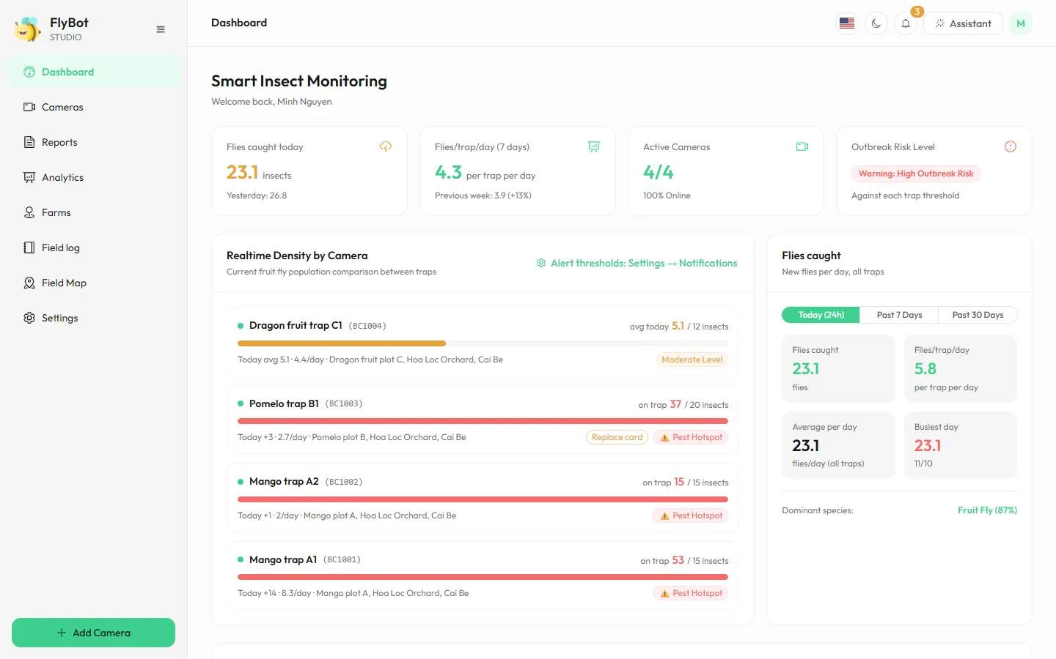
Smart insect traps: the camera shoots, the AI counts
FlyBot
Follow fruit flies and other pests on every trap, every day, right on your phone.
Web · Phone · English and Vietnamese
ezviz.agrhub.com
Notes:
Introducing FlyBot: insect traps watched by cameras, with an AI that counts the insects on each trap card and tells growers when density crosses a threshold.

Slide 2



Checking traps by hand is slow and always behind the pests
THE PROBLEM
Walking every trap, counting by eye
Scattered records
Spotted too late
Notes on paper are hard to compare across traps, plots and weeks.
By the time numbers look high, the outbreak has started and costs more to treat.
Each round takes hours of labour, and the count depends on who does it.
FlyBot · 2
Notes:
Today growers check traps by walking to each one and counting by hand. It takes time, the figures are hard to compare, and outbreaks are often noticed too late.

Slide 3

From trap card to decision, with no counting by hand
HOW IT WORKS
1
2
3
4
The camera shoots the trap
The AI finds and counts
Daily catches
Alerts and reports
New insects per day and flies per trap per day, to compare.
An EZVIZ camera takes photos on each trap's own schedule, daytime only if you like.
It boxes every insect in the photo, with its species and confidence.
An alert as soon as a threshold is reached; reports on a schedule.
FlyBot · 3
Notes:
Four steps: the camera photographs the trap card on a schedule, the AI finds and counts every insect, FlyBot works out the new catches per day, then it alerts and sends reports.

Slide 4
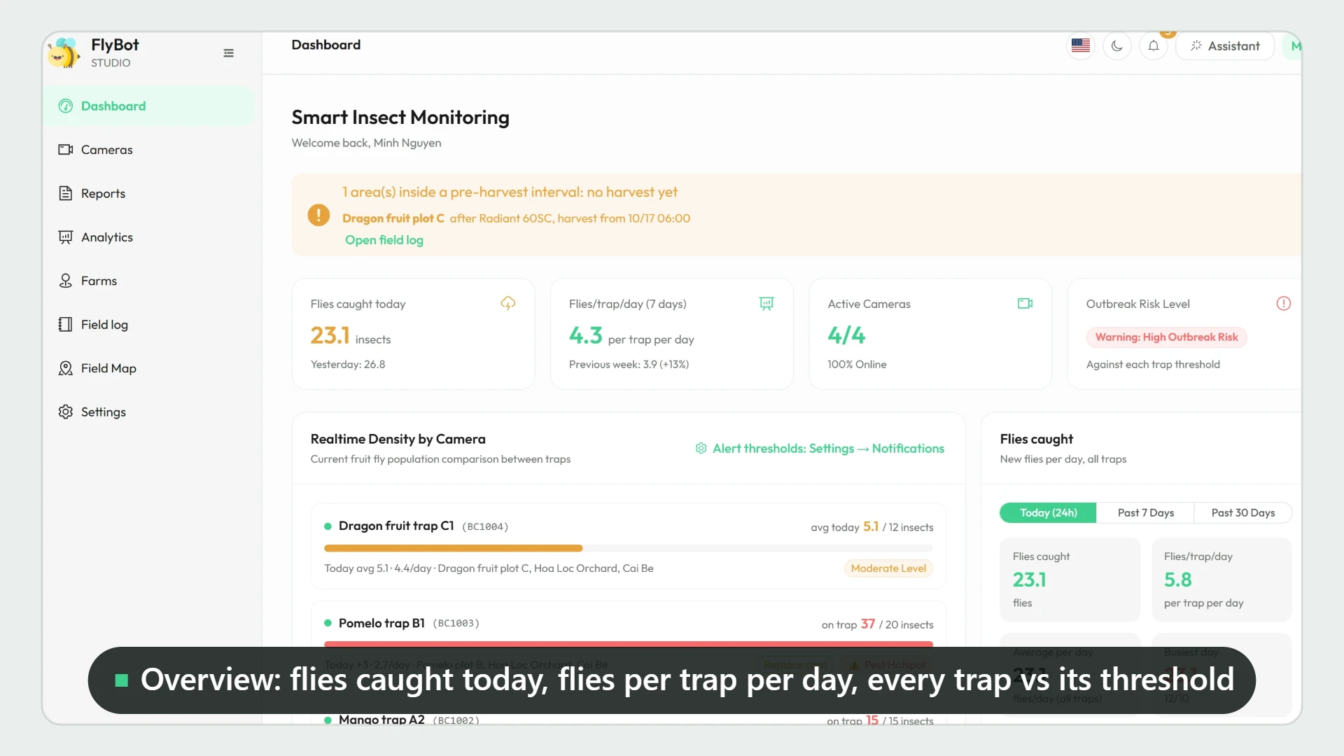
FlyBot in 86 seconds
PRODUCT TOUR
A walk through the app: overview, AI detection, cameras, analytics, reports, the FlyBot assistant, the VietGAP record and the quick tour.
▶ Watch the video online
It plays by itself when presented. In the PDF or PowerPoint file, click the video or the link above to watch the latest version on the website.
FlyBot · 4
Notes:
An 86-second tour of the main screens. It starts by itself when this slide is presented; click the video to pause it.

Slide 5
The whole farm on one screen
OVERVIEW
Catches today
New insects, not the running total on the sticky card.
Flies per trap per day
The standard figure to compare traps and weeks.
Risk for every trap
Against each trap's own threshold, with its latest AI photo.
FlyBot · 5
Notes:
The overview: catches today, flies per trap per day over 7 days against the week before, each trap's risk against its own threshold, a 14-day chart and a forecast.

Slide 6
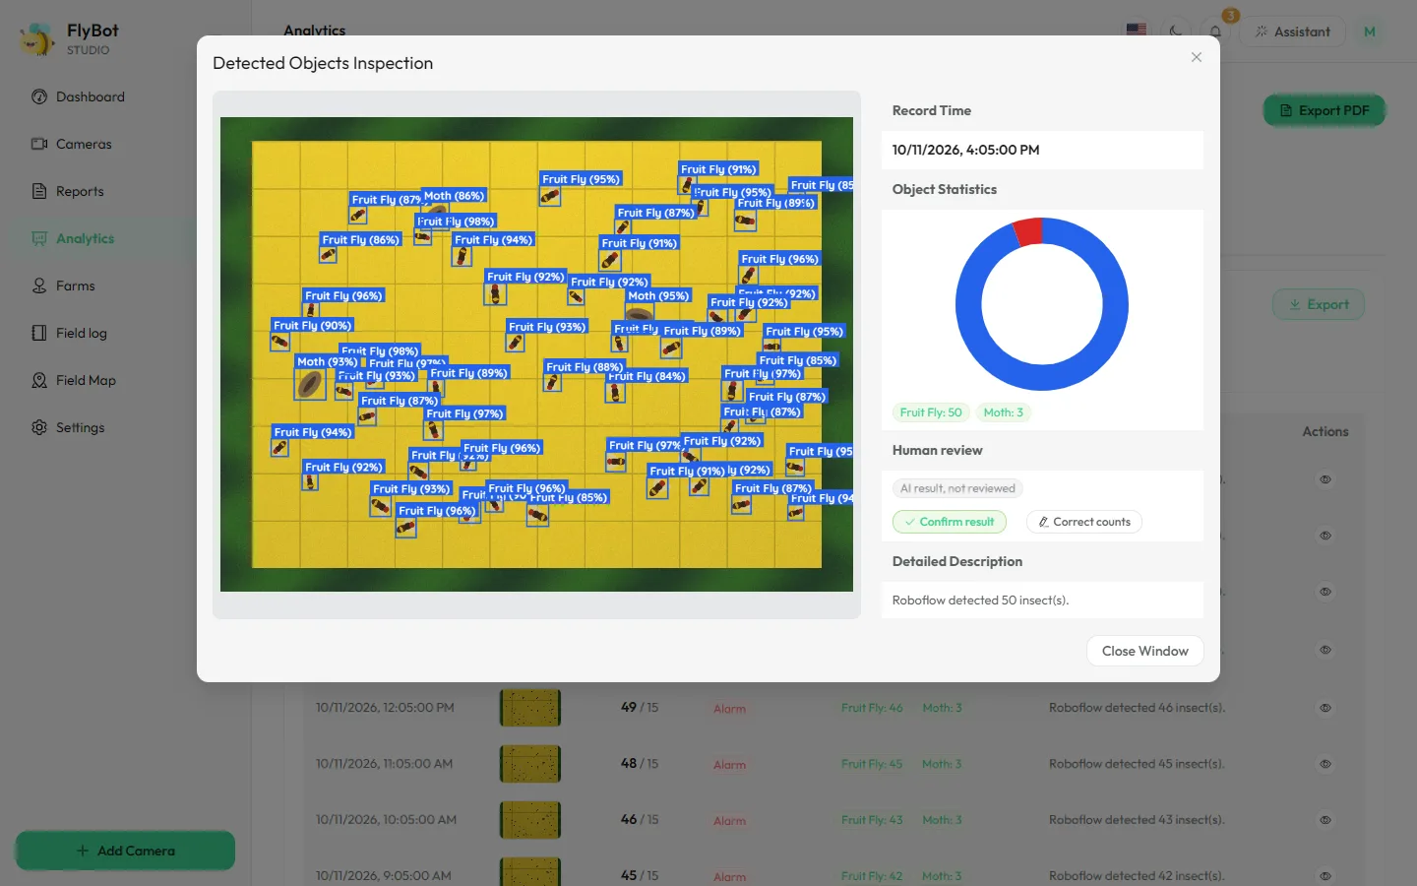
Every insect boxed and named
AI DETECTION
Boxes and species
Each insect gets a box, a species and a confidence; counts by species.
Measured accuracy
On 76 test photos: finds 92 of 100 flies; 93 of 100 boxes are fruit flies.
People review
Confirm the result or correct the count right on the photo.
An AI that improves
Reviewed photos are sent to retrain the model.
FlyBot · 6
Notes:
The AI boxes each insect in the photo with its species and confidence. Users can confirm or correct the count; reviewed photos are used to retrain the AI. Photos the AI failed on are retried automatically. The RF-DETR model was trained on 1,573 photos with over 85,000 marked flies; on 76 test photos its recall is 92%, precision 93%, mAP@50 96%.

Slide 7
Each kind of trap is read its own way
TWO KINDS OF TRAP
Sticky trap
Lure trap
Catches = the rise each day
Judged by the day's average
The glue card keeps every insect it caught. FlyBot counts the new ones since yesterday, skips card-change days, and reminds you when a card is due.
Flies come and go, so FlyBot uses the average per photo over the day. One crowded photo no longer raises a false alarm.
FlyBot · 7
Notes:
Choose the trap kind when adding a camera. Sticky traps: daily catches are the rise over the day before. Lure traps: the day's average per photo drives alerts, reports, the overview and the map.

Slide 8
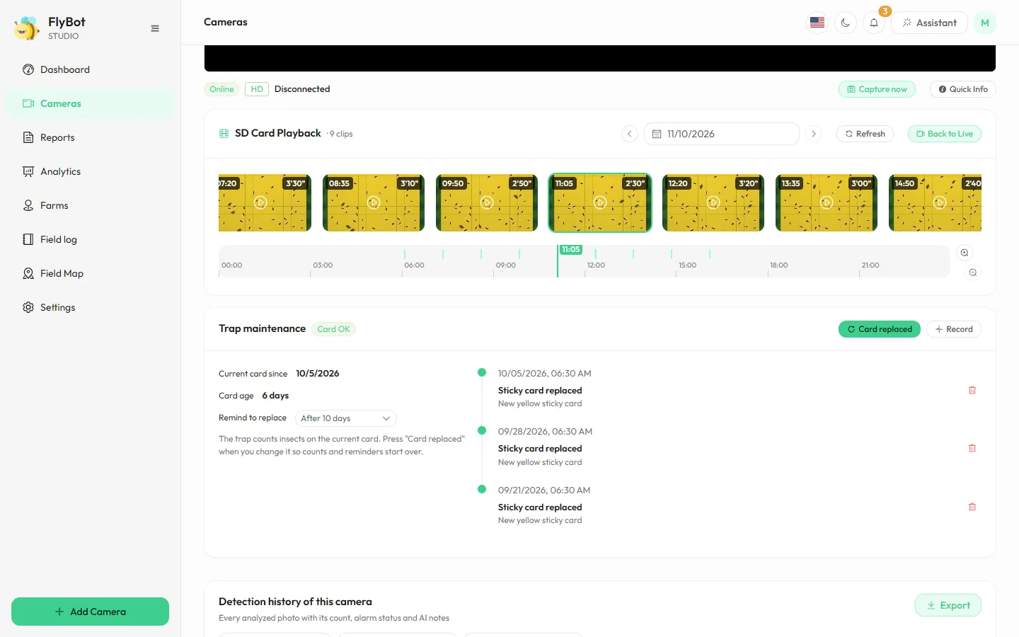
Watch live, play back and maintain traps
CAMERAS
Live and snap now
Live video from the camera; take and analyze a photo when you need one.
Timeline playback
Memory card recordings laid out by hour, day by day.
Trap maintenance
Log card changes and get a reminder when one is due.
FlyBot · 8
Notes:
The camera page: live video, take a photo now, play back memory card recordings on a timeline, log trap card changes and see the camera's own detection history.

Slide 9
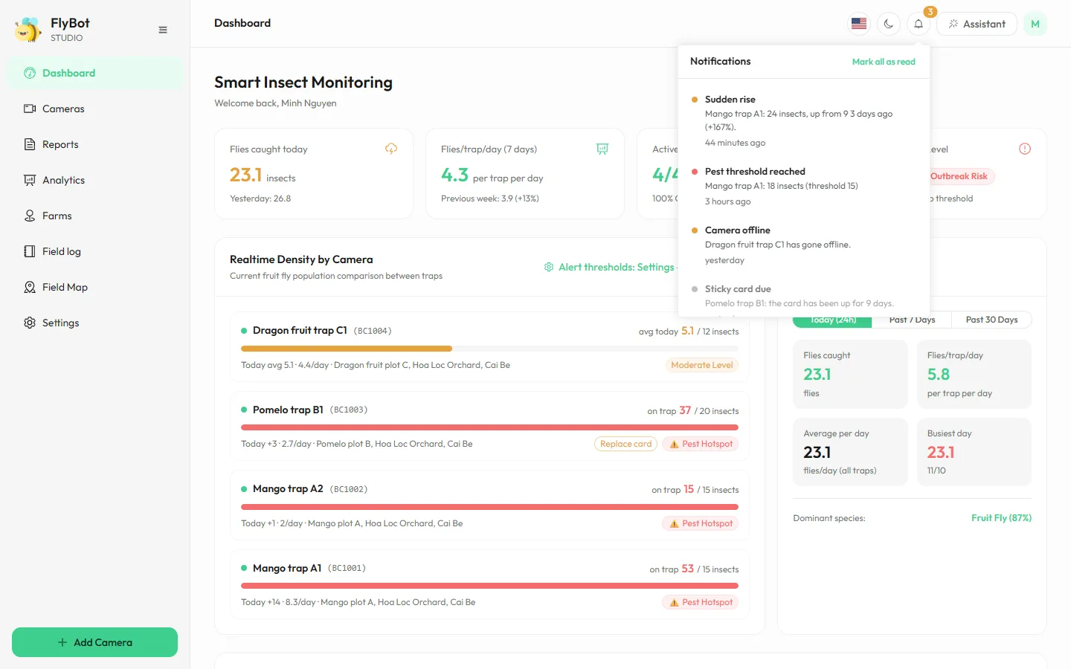
Know the moment you need to go out
ALERTS
At the right time
Trap threshold reached, sudden surge, camera offline, card due, OK to harvest.
On the right channel
In the app, push, email, Telegram; a 6:30 morning brief if turned on.
Never noisy
Pick the alert types, quiet hours and a cool-down between alerts.
FlyBot · 9
Notes:
Alerts when catches reach each trap's own threshold, on a sudden surge, when a camera goes offline, when a trap card is due, when the AI keeps failing, and when a pre-harvest interval ends. Delivered in the app, as push notifications, by email and on Telegram.

Slide 10
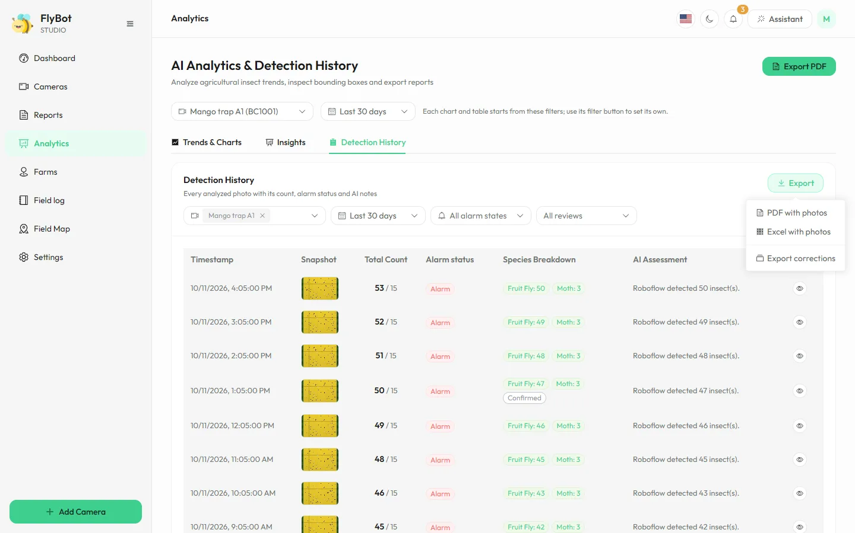
Every photo, filtered and exported
ANALYTICS AND HISTORY
In-depth analysis
Compare traps, temperature against catches, the busiest hours.
Filters that fit
By camera, period, alert level and review status.
Export with photos
PDF and Excel with boxed photos, one sheet per camera.
FlyBot · 10
Notes:
Analytics has trend charts, in-depth analysis by trap and by hour, and the history of every analyzed photo. Filter and export every match to PDF or Excel with photos.

Slide 11
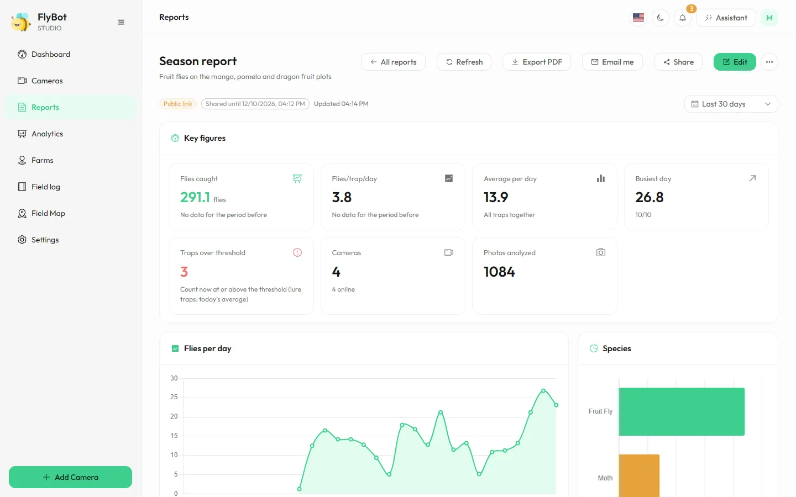
Reports that build and send themselves
REPORTS
Pick the blocks
Figures, charts, tables; 7 days to 12 months, against the period before.
On a schedule
Weekly or monthly, with the PDF, by email and Telegram.
Sharing that ends
Share with colleagues or a public link that expires.
FlyBot · 11
Notes:
Reports: choose blocks, a period and filters per block, export to PDF, share with people or through a public link with an end date, and send them automatically every week or month by email and Telegram.

Slide 12



Ask in plain words; it looks up and acts
AI ASSISTANT
You ask
It picks its tools
Answers and guides
"Which trap is worst?"
"Did last week's spray work?"
"I replaced the card on trap A1."
Trap figures, week-on-week, alerts, reports, logbook; looks at a photo; takes a photo, emails a report.
Streams its answer with photos and charts, opens the right screen. Changes are saved only on your Confirm.
The assistant only sees the cameras you may see, and never changes settings or accounts.
FlyBot · 12 · Full guide: ezviz.agrhub.com/manual
Notes:
The AI assistant (the Assistant button at the top) is an agent: it calls FlyBot's own tools to get real figures before answering, compares weeks, reads alerts, reports and the farm logbook (with the effect of each treatment), can look at one photo (the "Ask the assistant about this photo" button), take a photo from a camera, email a report as a PDF and open the right screen. Answers stream in with photo, chart and comparison cards. A card change or a treatment is saved only when the user presses Confirm. Conversations are kept for 7 days. It follows the same camera access rules as the app and cannot change settings or accounts.

Slide 13
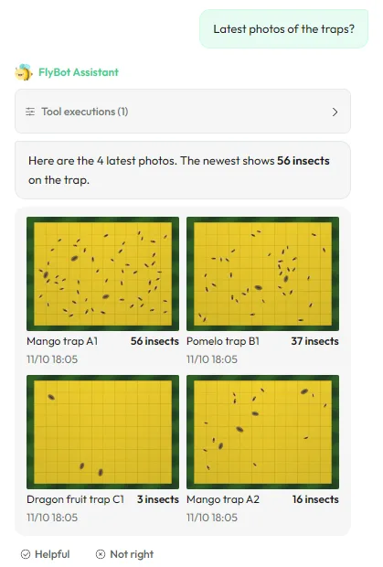
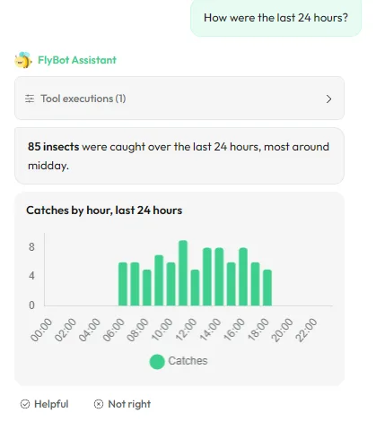
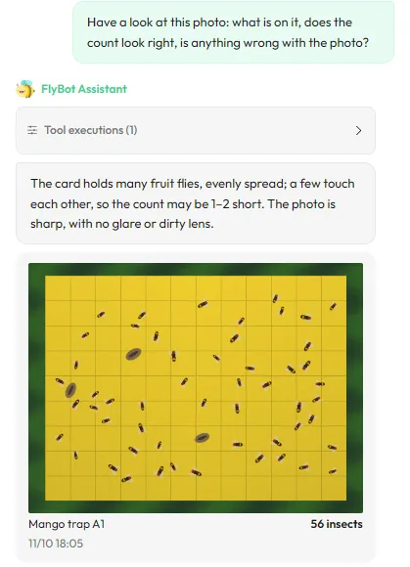
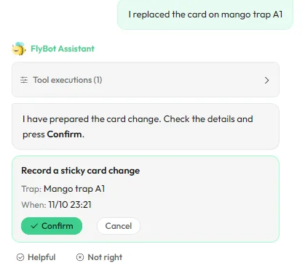
Answers with photos, charts and buttons
THE ASSISTANT IN THE APP
Latest AI photos
Charts in the chat
Ask about a photo
Saved on your Confirm
FlyBot · 13 · Full guide: ezviz.agrhub.com/manual
Notes:
Four examples in the chat panel: asking for the latest photos brings the AI photos; asking about the last 24 hours brings a chart by hour; "Ask the assistant about this photo" has the AI look at it; saying "I replaced the card" prepares a card that is saved only when you press Confirm.

Slide 14
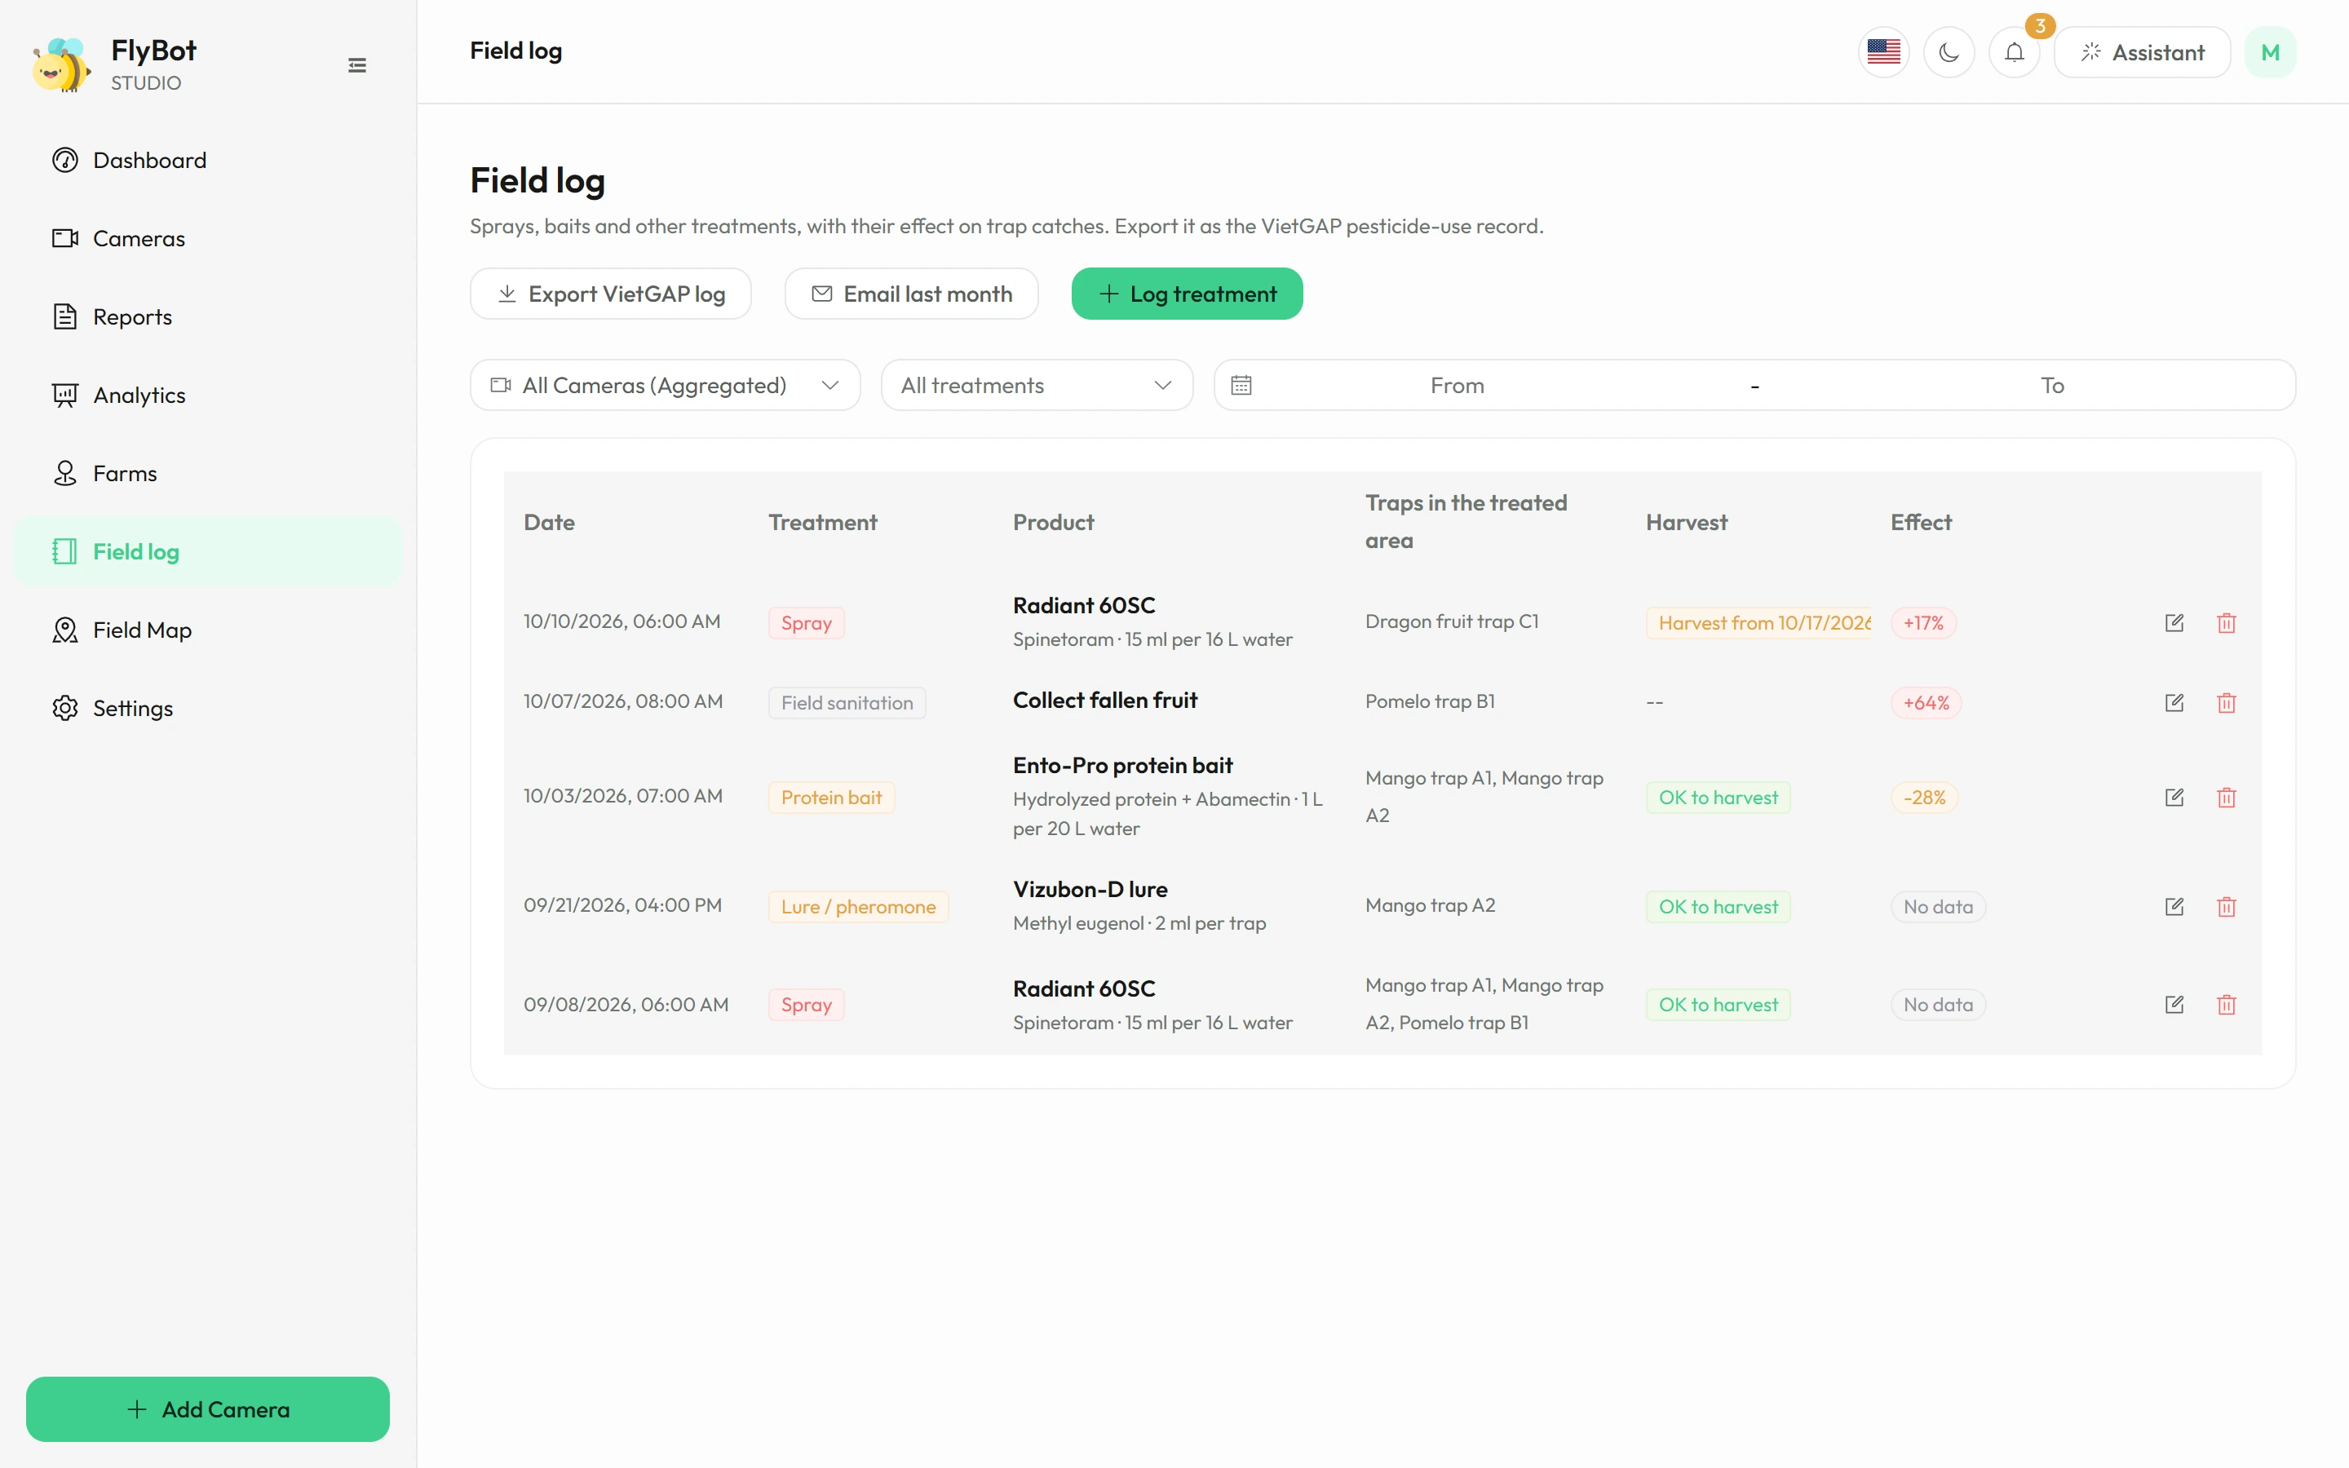
See which treatments really work
FARMS, MAP AND LOGBOOK
Farms, plots and map
Traps belong to plots; a heat map shows the pest hot spots.
Treatment log
Every spray or bait with its measured effect; when harvest is allowed again.
VietGAP record
The pesticide use record in the VietGAP layout, emailed as a PDF on the 1st.
FlyBot · 14
Notes:
Manage farms and plots, place traps on the map and view the heat map. The logbook records each treatment and works out its effect on catches; it exports a VietGAP pesticide use record and can email last month's record as a PDF on the 1st of each month. After a spray with a pre-harvest interval, FlyBot shows which areas cannot be harvested yet and sends a notice the morning the interval ends.

Slide 15
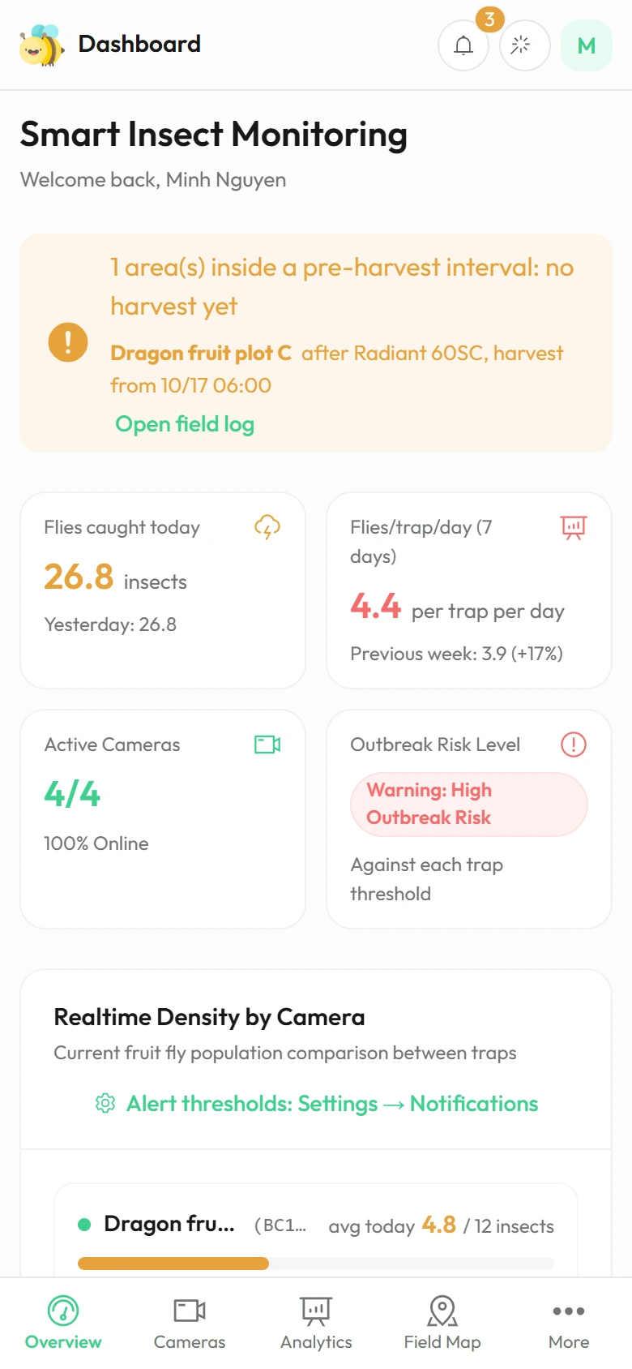
The whole team on board, each with the right access
PHONE AND TEAM
Installs like an app
Roles
Push notifications, English and Vietnamese; opens even without signal.
Admin, manager, viewer; share single cameras or a whole organization.
Connects to your systems
Operations in view
API keys and webhooks to bring the data into your own software.
An activity log and a capture pipeline monitor for admins.
FlyBot · 15
Notes:
FlyBot installs on the phone like an app, with push notifications, in English and Vietnamese, and opens in the field without signal with the last data seen. Role-based access, camera and organization sharing, API and webhooks, an activity log and a capture pipeline monitor for admins.

Slide 16
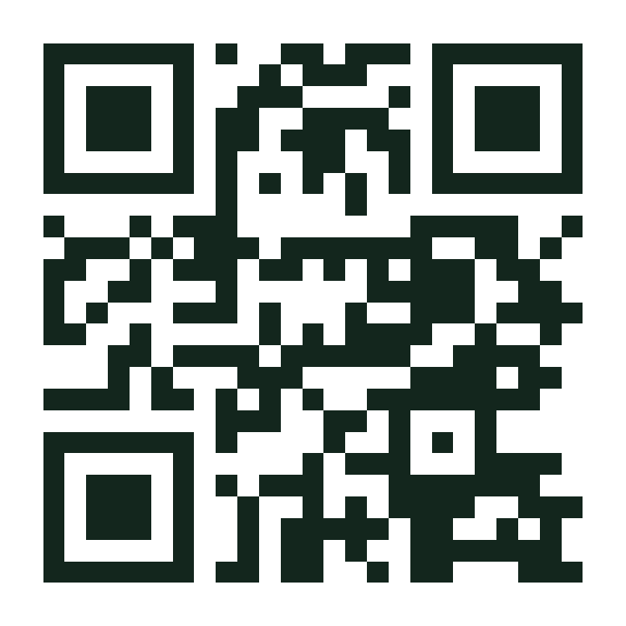
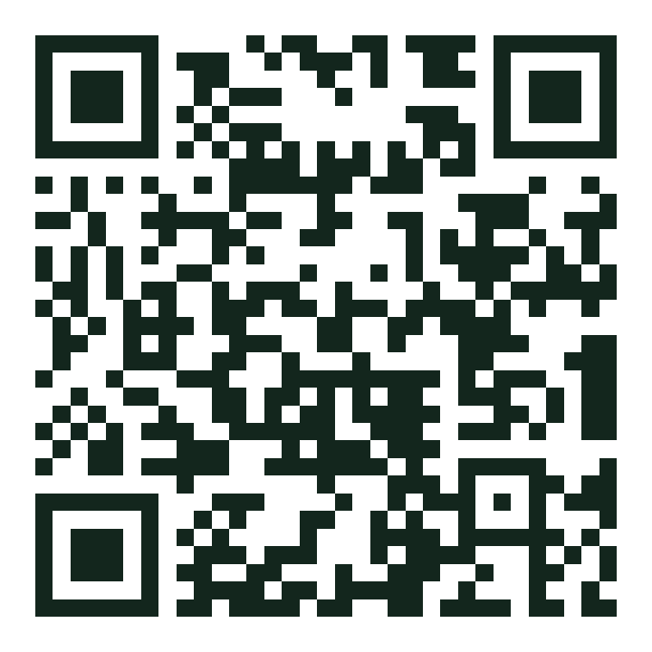
Three steps to your first self-reporting trap
GET STARTED
01
02
03
Mount a camera on the trap
Add it to FlyBot
Set thresholds and channels
An EZVIZ camera facing the sticky card or the lure trap.
Enter the serial number and verification code, pick the trap kind and schedule.
A threshold per trap; alerts by phone, email and Telegram.
Open the app
Watch the 86-second tour
ezviz.agrhub.com
Scan with your phone camera
Contact: contact@agrhub.com · ezviz.agrhub.com · Guide · Product tour
Notes:
Three steps: mount an EZVIZ camera on the trap, add it with its serial number and verification code and choose the trap kind, then set the alert threshold and channels. Contact contact@agrhub.com or visit https://ezviz.agrhub.com. The two QR codes open the app and the product tour on a phone.

